Slide 1

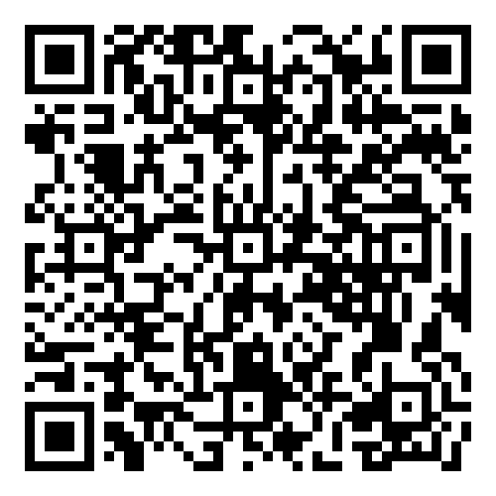
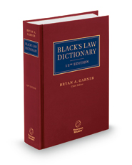


ブラック法律辞典（第１２版）
Black's Law Dictionary, Standard edition 12th ed.
発売中
※大学生協洋書オンラインストアの該当商品のページへ
The 12th edition of Black’s Law Dictionary is the new standard — the most comprehensive English-language law dictionary ever compiled, with more than 70,000 entries containing precise definitions and more than 4,800 scholarly and judicial quotations on legal terminology. Every page has been supplemented and revised.
There’s a good reason why Black’s is the dictionary of record in American law and renowned worldwide: it’s the most extensive, accurate, clearly drafted, and authoritative dictionary ever written for the legal profession and for anyone else needing legal definitions. When you use this dictionary, you’re using a trusted and respected resource.
While Black’s originated in 1891, you’ll immediately see why it flourishes today and why it has continued as the benchmark reference book. This new edition keeps the dictionary timely and updated, but at the same time deepens the historical scholarship. Under the chief editorship of Bryan A. Garner, our expert editors and contributors have captured the most current terminology and definitions. With this indispensable tool, busy legal writers can quickly grasp the essence of an unfamiliar term and stay current on their legal knowledge.
●著者：
●出版社：Thomson West Publishing International Division
●刊行：2024年6月
●ISBN：979-8-3502-9089-9
●出版国アメリカ合衆国
●​​装丁 hardcover/2,098P.
●分野：
組合員価格は生協店舗にお尋ねください
＊海外からの仕入れのため為替レートの変動により価格は変動します。
研究費・科研費でのご購入は生協が便利で安心！
注文書
Black's Law Dictionary, Standard edition 12th ed ご注文 冊
氏名: TEL: お支払方法（○で囲む） 校費・私費
学部名； 学科名： 研究科or研究室名：
大学生協洋書オンラインストア
https://yosho.univcoop.jp/BookShop/
発行：2024年06月25日

Slide 2
Black's Law Dictionary, Deluxe edition 12th ed.
[出版社] Thomson West Publishing International Division
[出版年月日]
[ISBN-13] 979-8-3502-9090-5
[出版国] アメリカ合衆国
[装丁] hardcover/Geb./rel.
2024年7月刊行予定

