Slide 1
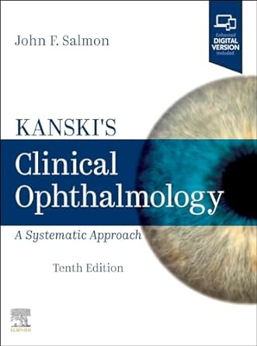
Medical Book Information from UNIV. CO-OP
カンスキー・臨床眼科学 第10版
Kanski's Clinical Ophthalmology:
A Systematic Approach, 10th ed.
2024年8月
刊行予定
※大学生協洋書オンラインストアの該当商品のページへ
Filled with stunning images and in-depth information on both common and rare ophthalmic diseases and disorders, Kanski's Clinical Ophthalmology: A Systematic Approach, 10th Edition, is both a foundational knowledge source for trainees and a valuable reference for experienced practitioners.
Dr. John Salmon, from the University of Oxford, has meticulously revised this classic text, retaining
Dr. Kanski’s highly effective format of succinct text and visually dynamic presentation. Extremely well organized and comprehensive in scope, it provides authoritative, focused guidance on diagnosis and management, facilitating quick comprehension to enhance learning, aid exam preparation,
and guide clinical practice.
●出版社：Elsevier UK ●出版年月日：2024/8 ●ISBN-13：978-0-443-11099-3 ●出版国：イギリス ●装丁：hardcover ●ページ数：968 p., 2600
●ジャンル：眼科学
組合員価格は生協店舗にお尋ねください
＊海外からの仕入れのため為替レートの変動により価格は変動します。
ご容赦ください。
Kanski‘s Clinical Ophthalmology:A Systematic Approach, 10th ed./カンスキー・臨床眼科学 第10版 全2巻
ご注文 冊.
氏名: TEL: お支払方法（○で囲む） 校費・私費
学部名； 学科名： 研究科or研究室名：
ご注文日： 年 月 日 受付者： 店名
大学生協洋書オンラインストア
https://yosho.univcoop.jp/BookShop/
発行：2024年05月07日

Slide 2
Key Features
Uses targeted text, bulleted lists, tables and visual aids to highlight salient points across all ophthalmology subspecialties.
Features more than 2,800 high-quality illustrations, including over 2,000 images depicting both common and rare conditions, with arrows to show the exact pathology.
Includes the latest developments in cataract and refractive surgery, glaucoma, diabetes, macular degeneration, retinal vascular disease, pachychoroid disease, posterior uveitis, inflammatory eye disease, multiple sclerosis, thyroid eye disease, tumors, immunotherapy and genetics.
Contains new, detailed illustrations of eye anatomy; improved case examples; and expanded sections on headache, seventh nerve palsy, cerebral visual impairment and Parkinson disease.
Uses state-of-the-art imaging modalities such as OCT, OCT-A, fundus autofluorescence and ICG angiography to demonstrate subtle choroidal and retinal pathology.
Offers detailed coverage of rare conditions: monkey pox infection, COVID conjunctivitis, silent sinus syndrome, torpedo maculopathy, CRB-1 associated retinal dystrophy, sagging eye syndrome and SLE scleritis.
An eBook version is included with purchase. The eBook allows you to access all of the text, figures, and references, with the ability to search, customize your content, make notes and highlights, and have content read aloud. Any additional digital ancillary content may publish up to 6 weeks following the publication date.

